Slide 1
Community detection in networks
BVCN Network Science
Dr. Joy Buongiorno

Slide 2
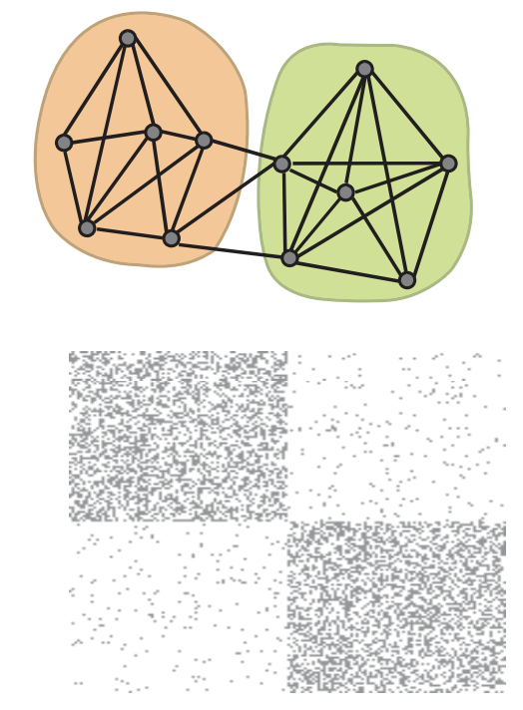
Community Discovery
Community or module: group of nodes with dense internal connections, but few connections to other communities.
Community discovery: given a graph, divide it into good communities.
Newman and Girvan 2002: Community structure in social and biological networks
https://doi.org/10.1073/pnas.122653799
Fortunato 2016: https://arxiv.org/abs/1608.00163

Slide 3
Two main questions:
1. How do we find good communities?
2. What will these communities correspond to?

Slide 4
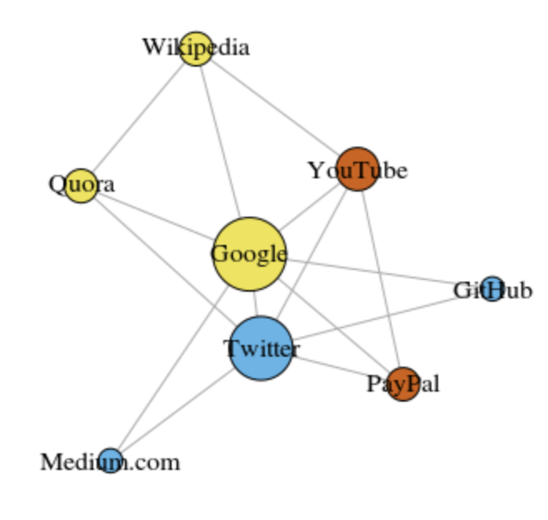
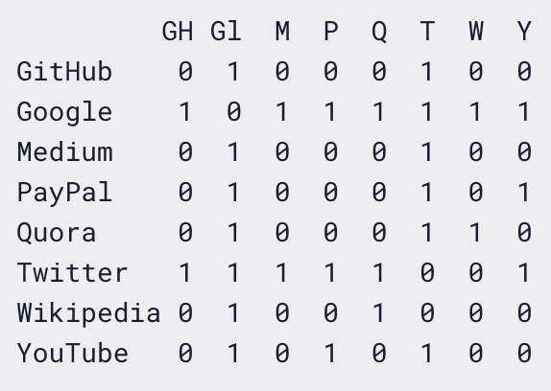
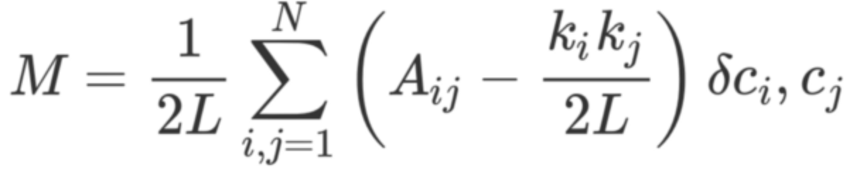
1. How do we find good communities?
Identify clusters of nodes that are more connected to each other than they are to nodes outside of a cluster.
"Good" often means: high modularity
Quick unweighted example from freecodecamp.org
Adjacency matrix A
Degree (K)
Difference between the network’s real structure and the expected structure of a random network.
+
+
+
+
+
+
+
2
+
+
+
+
+
+
+
7
+
+
+
+
+
+
+
2
+
+
+
+
+
+
+
3
+
+
+
+
+
+
+
3
+
+
+
+
+
+
+
6
+
+
+
+
+
+
+
2
+
+
+
+
+
+
+
3
1 if i and j are in same cluster, 0 if not.
(Kronecker-delta fxn)
The value in adjacency matrix A at row i, column j.
/2
= 14 = Edges (L)
8 = Nodes (N)
28
Notes:
https://www.freecodecamp.org/news/how-machines-make-sense-of-big-data-an-introduction-to-clustering-algorithms-4bd97d4fbaba/

Slide 5
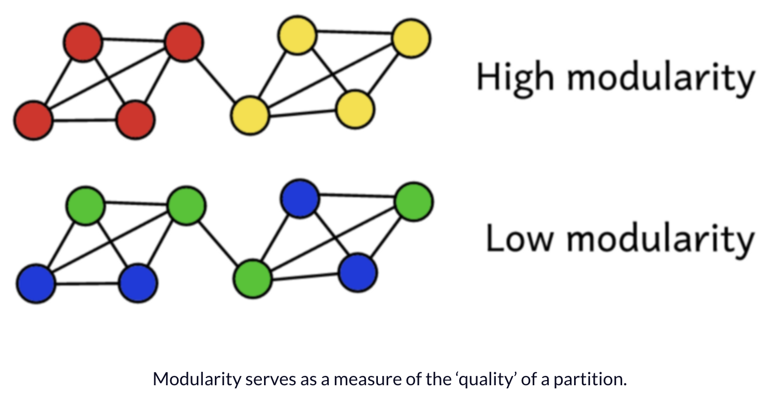
Modularity is bounded between 0 and 1, with higher values indicating higher modularity.

Slide 6
Igraph has many module detection algorithms that optimize the modularity score. Here are two:
cluster_fast_greedy()
This function tries to find dense communities in graphs via directly optimizing a modularity score.
https://igraph.org/r/doc/cluster_fast_greedy.html
cluster_louvain()
This function implements a multi-level modularity optimization algorithm for finding community structure.
It is based on the modularity measure and a hierarchial approach. Initially, each vertex is assigned to a community on its own.
In every step, vertices are re-assigned to communities in a local, greedy way:
each vertex is moved to the community with which it achieves the highest contribution to modularity.
When no vertices can be reassigned, each community is considered a vertex on its own, and the process starts again
with the merged communities. The process stops when there is only a single vertex left or when the modularity cannot be
increased any more in a step. -- https://igraph.org/r/doc/cluster_louvain.html
https://towardsdatascience.com/louvain-algorithm-93fde589f58c

Slide 7
Also have:
Random walks -- A random walk means that we start at one node, choose a neighbor to navigate to at random or based on a provided probability distribution, and then do the same from that node, keeping the resulting path in a list. If a random walk returns a small set of nodes repeatedly, then it indicates that those set of nodes may have a community structure. https://igraph.org/r/doc/random_walk.html
Label propagation – Fast detection algorithm in which nodes can be assigned preliminary labels to narrow down the range of solutions generated. This means that it can be used as semi-supervised way of finding communities where we hand-pick some initial communities. https://igraph.org/r/doc/cluster_label_prop.html
Leading eigenvector – A top-down hierarchical approach that optimizes the modularity function again. In each step, the graph is split into two parts in a way that the separation itself yields a significant increase in the modularity. The split is determined by evaluating the leading eigenvector of the so-called modularity matrix, and there is also a stopping condition which prevents tightly connected groups to be split further. Due to the eigenvector calculations involved, it might not work on degenerate graphs where the ARPACK eigenvector solver is unstable. On non-degenerate graphs, it is likely to yield a higher modularity score than the fast greedy method, although it is a bit slower.
Edge betweenness – Calculates the edge betweenness of the graph, removing the edge with the highest edge betweenness score, then recalculating edge betweenness of the edges and again removing the one with the highest score, etc. https://igraph.org/r/doc/cluster_edge_betweenness.html
Spinglass – Uses a spin-glass model and simulated annealing. https://igraph.org/r/doc/cluster_spinglass.html
This resource is helpful for definitions https://neo4j.com/docs/graph-algorithms/current/introduction/

Slide 8
Two main questions:
1. How do we find good communities?
2. What will these communities correspond to?

Slide 9
2. What do these communities correspond to?
Information/reference websites
Online publishing
Youtube, which was founded by former Paypal employees

Slide 10
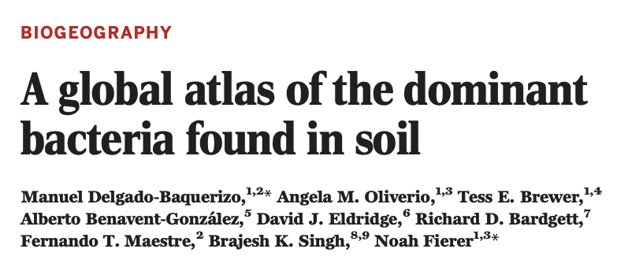
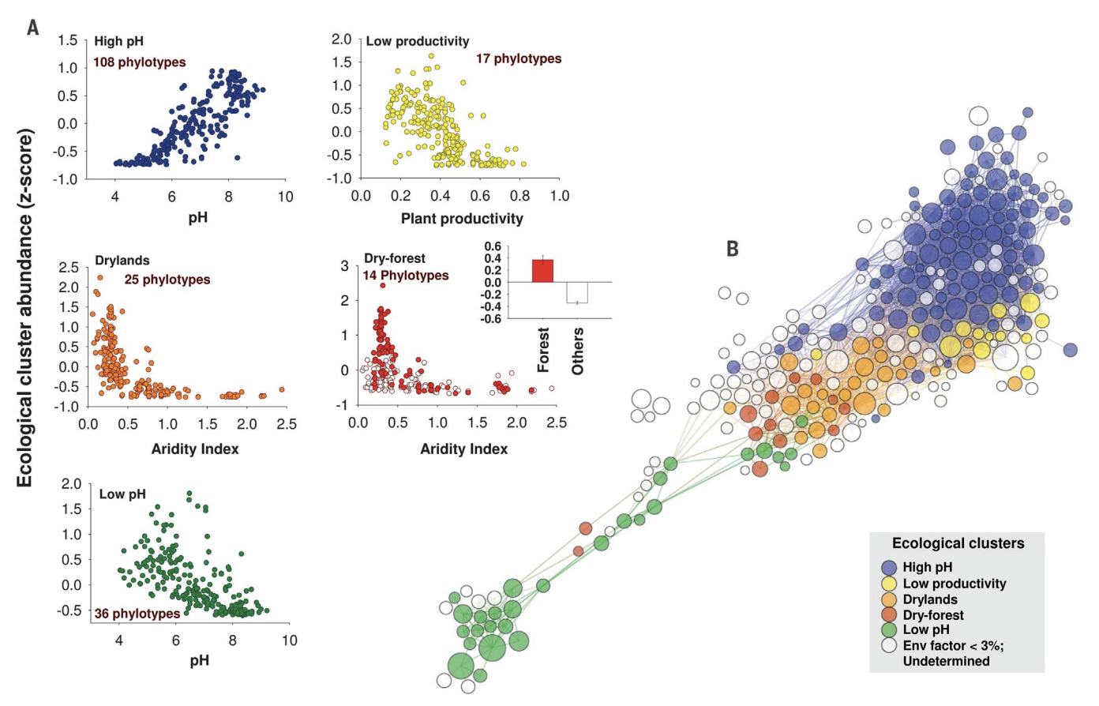
Biological example
Used cluster analysis to guide correlation between different bacterial phylotypes and environmental parameters.

